Slide 1
Exam Management Systems
Foong Ghin Yew Liu Yik Cheng
15WAU09184 15WAR09183
RMB3 RMB3

Slide 2
Objective:

Slide 3






Slide 4
TASKS:
Collect attendance of exam candidates
Collect attendance of staff
Exam Bundle Collection

Slide 5
Process of Attendance Collection:

Slide 6

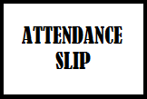
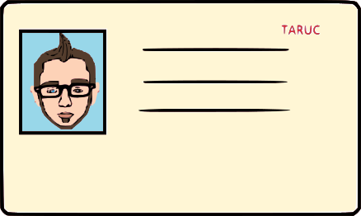



Table: 32
Index: W020003AUMB

Slide 7


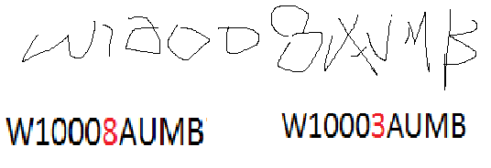


Human Error:
Inefficient
Table: 32
Index: W020003AUMB

Slide 8
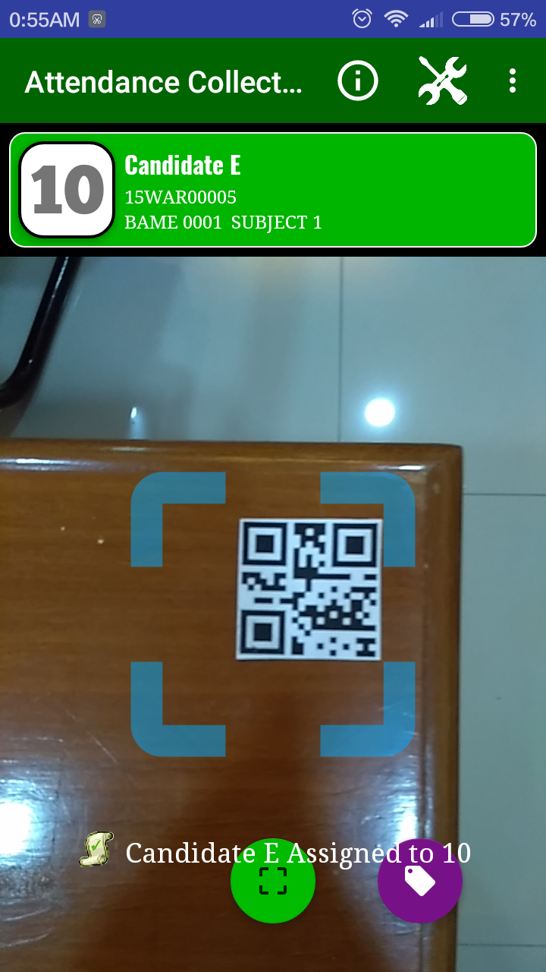
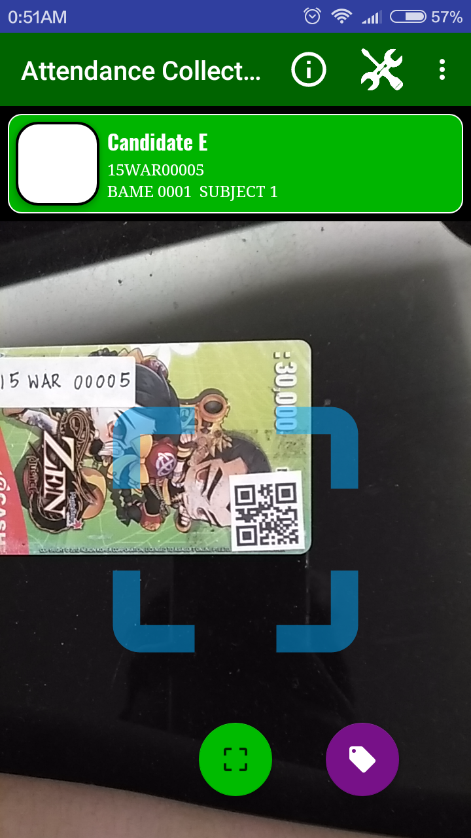

Slide 9
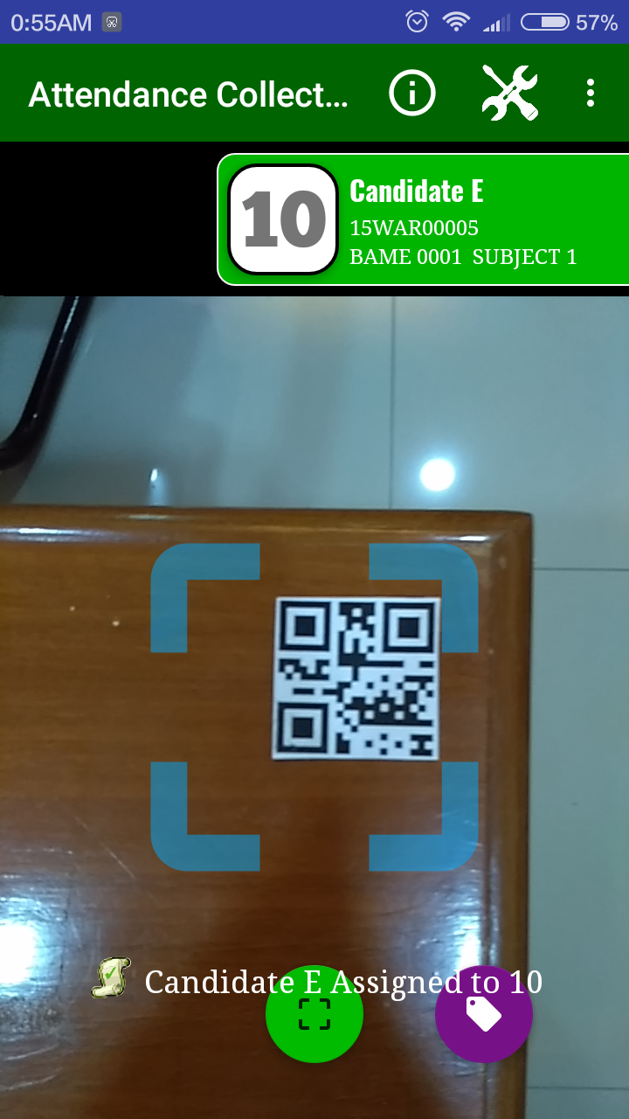
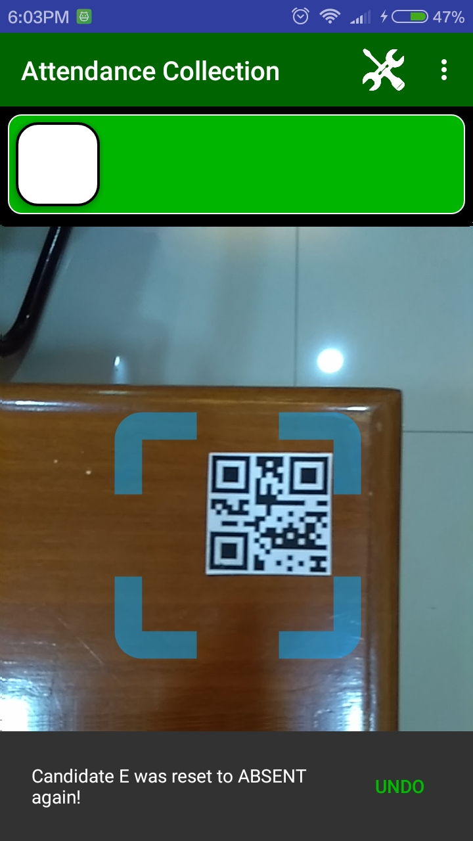

Slide 10
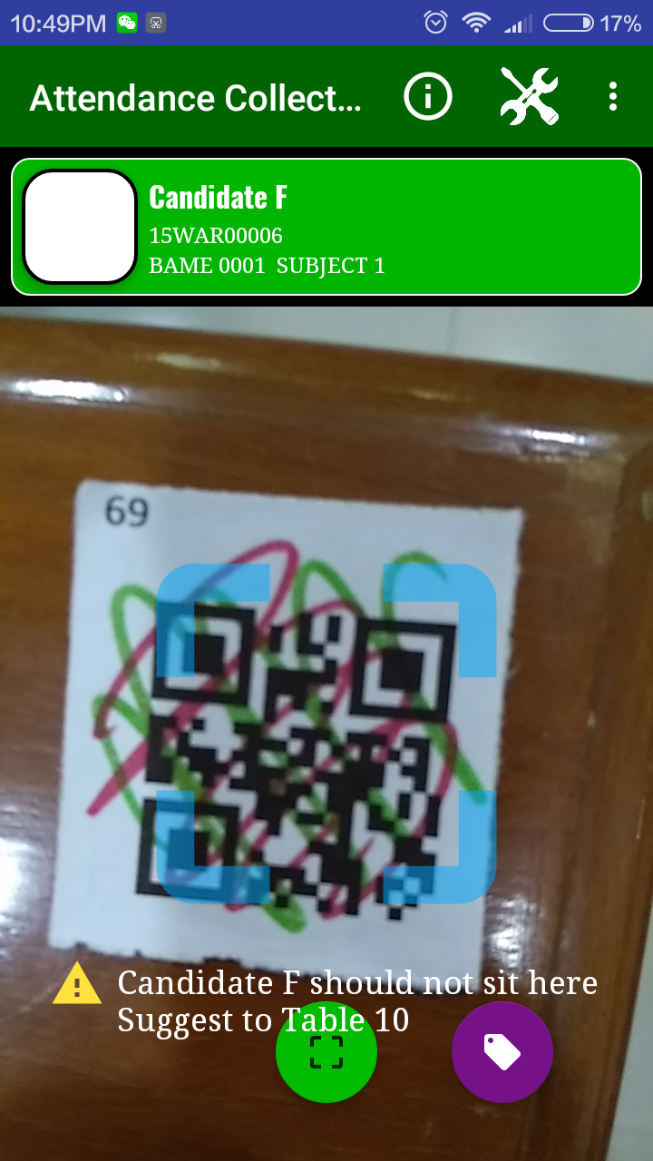
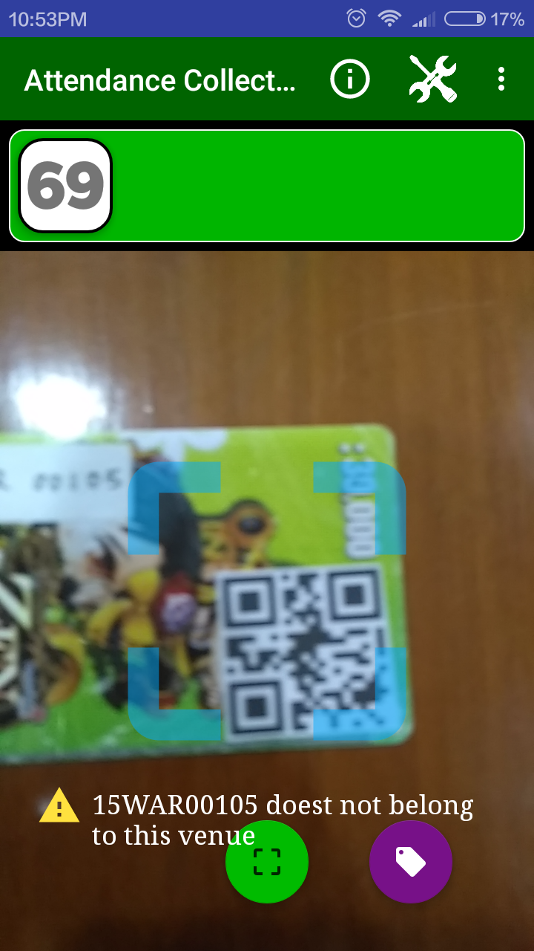
Verification:

Slide 11
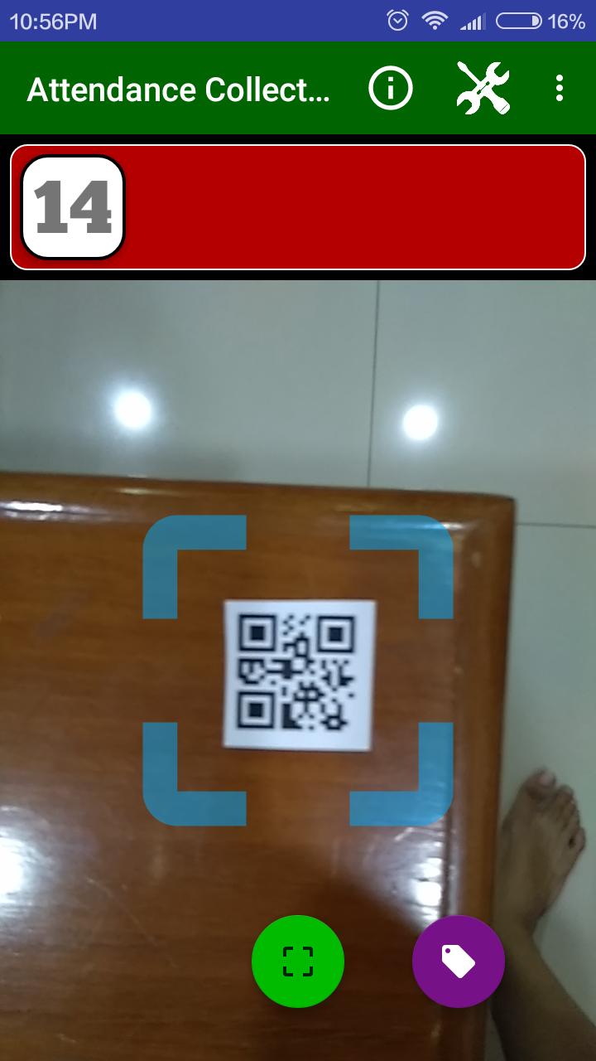
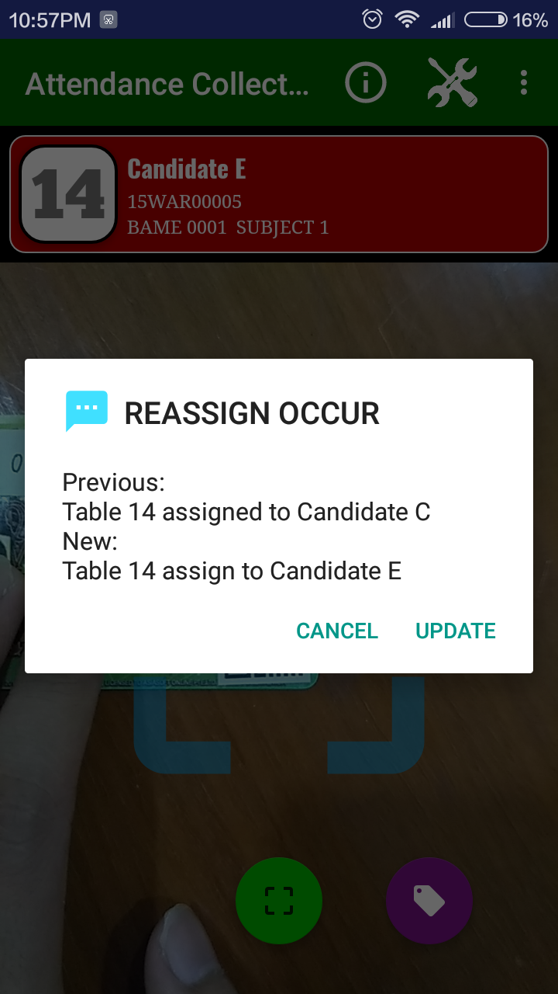
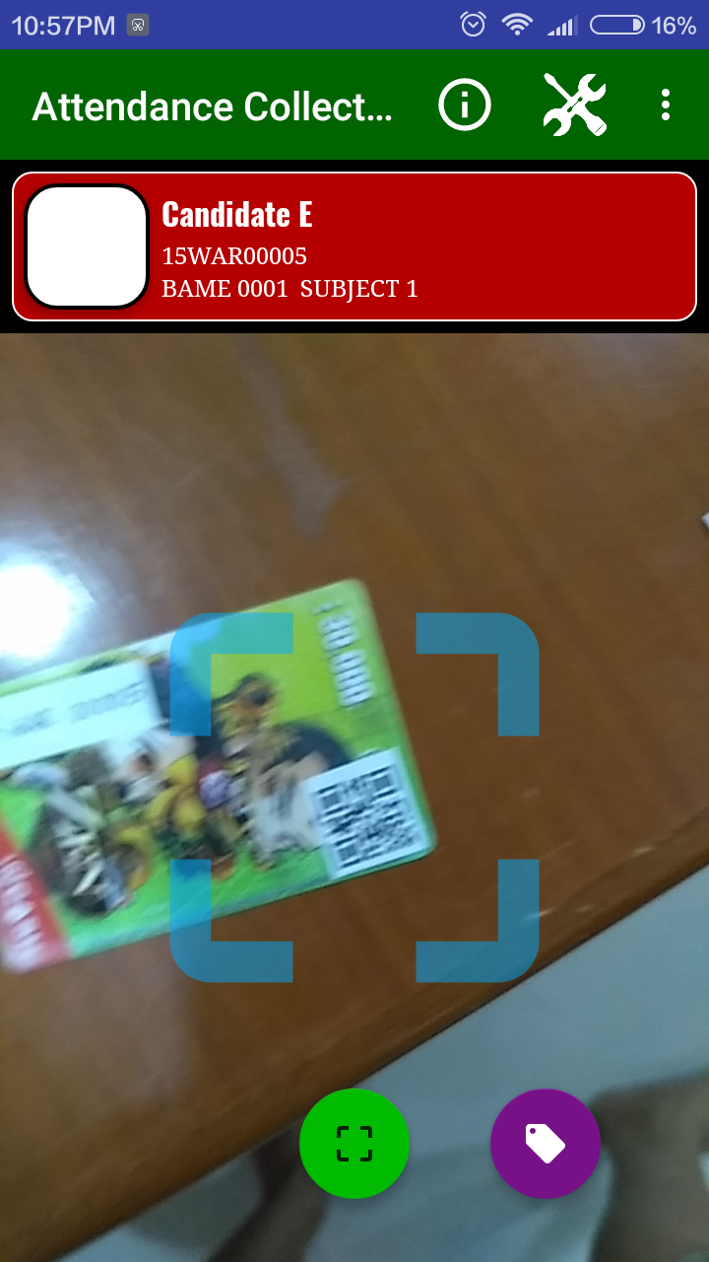
Reassign

Slide 12
Where the DATA
come from?

Slide 13
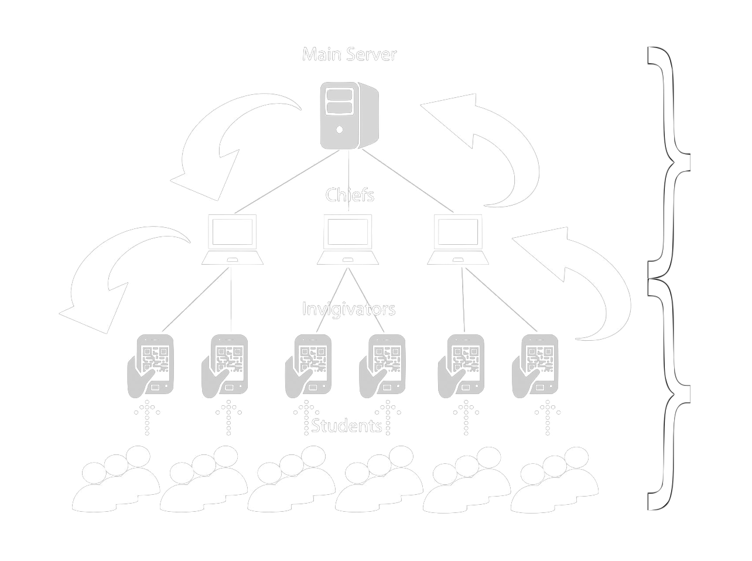

Slide 14

Candidate Attendance List
Relational Database
Programme | Candidate ID | Paper | Venue | Status | Attendance
RMB3 | 15WAR00001 | BAME2001 | M1 | ELIGIBLE | ABSENT
AMB2 | 15WAR00002 | MPU3231 | M2 | ELIGIBLE | ABSENT
DMC1 | 15WAR00003 | BAME3331 | M1 | ELIGIBLE | ABSENT
RPS2 | 15WAR00004 | BAME3331 | M2 | BARRED | ABSENT

Slide 15
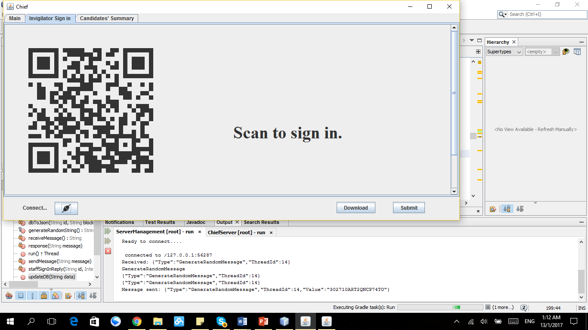

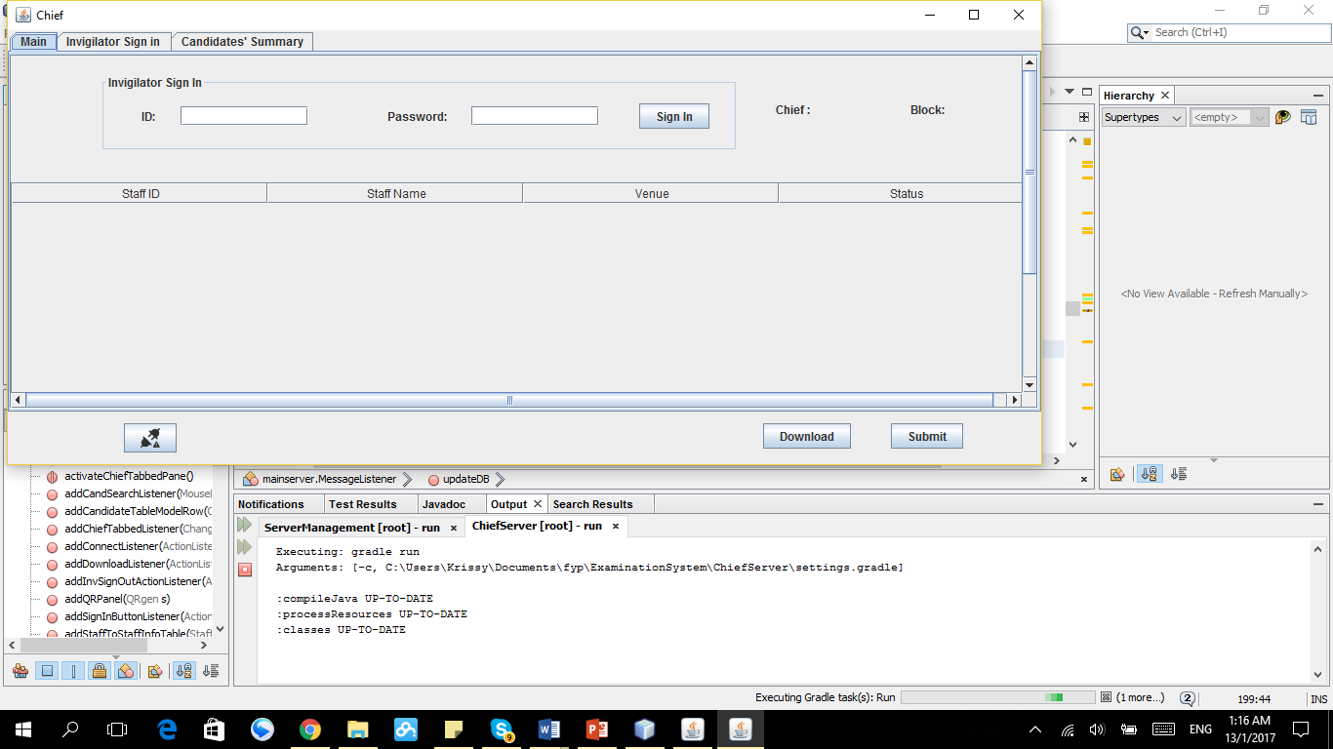
Invigilator Sign In
Sign in by typing ID and password manually

Slide 16
Relational Database
Cand. No. | Candidate ID | Paper No.
1 | 15WAR00001 | 1
2 | 15WAR00003 | 2
3 | 15WAR00004 | 2
Paper No. | Paper Code
1 | BAME2001
2 | BAME3331
Unique
Cand No. | Candidate ID | Paper No. | Paper Code
1 | 15WAR00001 | 1 | BAME2001
2 | 15WAR00003 | 2 | BAME3331
3 | 15WAR00004 | 2 | BAME3331

Slide 17
Invigilator List
Staff ID | Role | Venue | Attendance | Sign In Time
Staff1 | In-Charge | M1 | Present | 13:45:20
Staff2 | Invigilator | M1 | Absent
Staff3 | In-Charge | M2 | Absent

Slide 18
Candidate Attendance List
Programme | Candidate ID | Paper | Status | Attendance
RMB3 | 15WAR00001 | BAME2001 | ELIGIBLE | ABSENT
DMC1 | 15WAR00003 | BAME3331 | ELIGIBLE | ABSENT
M1
Staff1
Programme | Candidate ID | Paper | Venue | Status | Attendance
RMB3 | 15WAR00001 | BAME2001 | M1 | ELIGIBLE | ABSENT
AMB2 | 15WAR00002 | MPU3231 | M2 | ELIGIBLE | ABSENT
DMC1 | 15WAR00003 | BAME3331 | M1 | ELIGIBLE | ABSENT
RPS2 | 15WAR00004 | BAME3331 | M2 | BARRED | ABSENT
Programme | Candidate ID | Paper | Status | Attendance
AMB2 | 15WAR00002 | MPU3231 | ELIGIBLE | ABSENT
RPS2 | 15WAR00004 | BAME3331 | BARRED | ABSENT
M2
Staff2

Slide 19
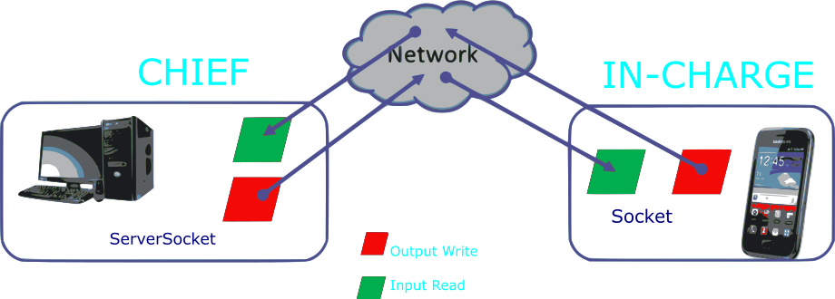

Slide 20
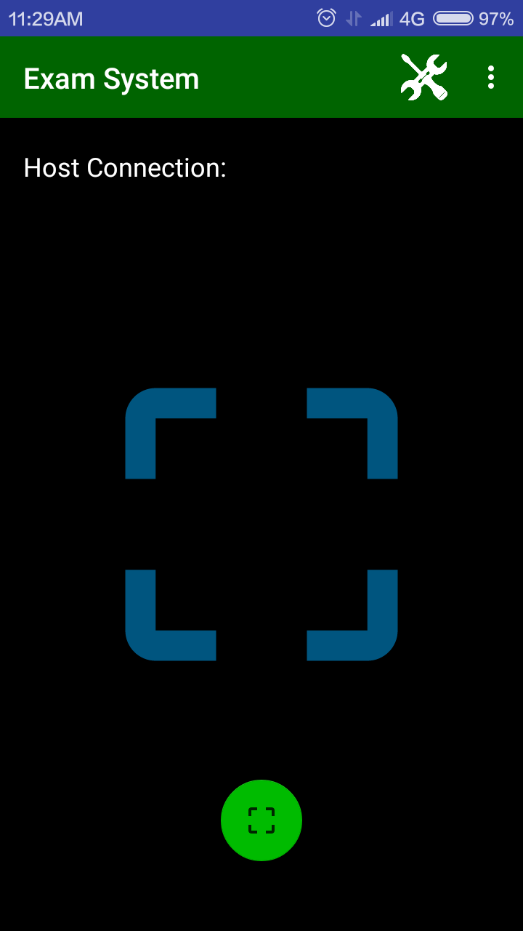
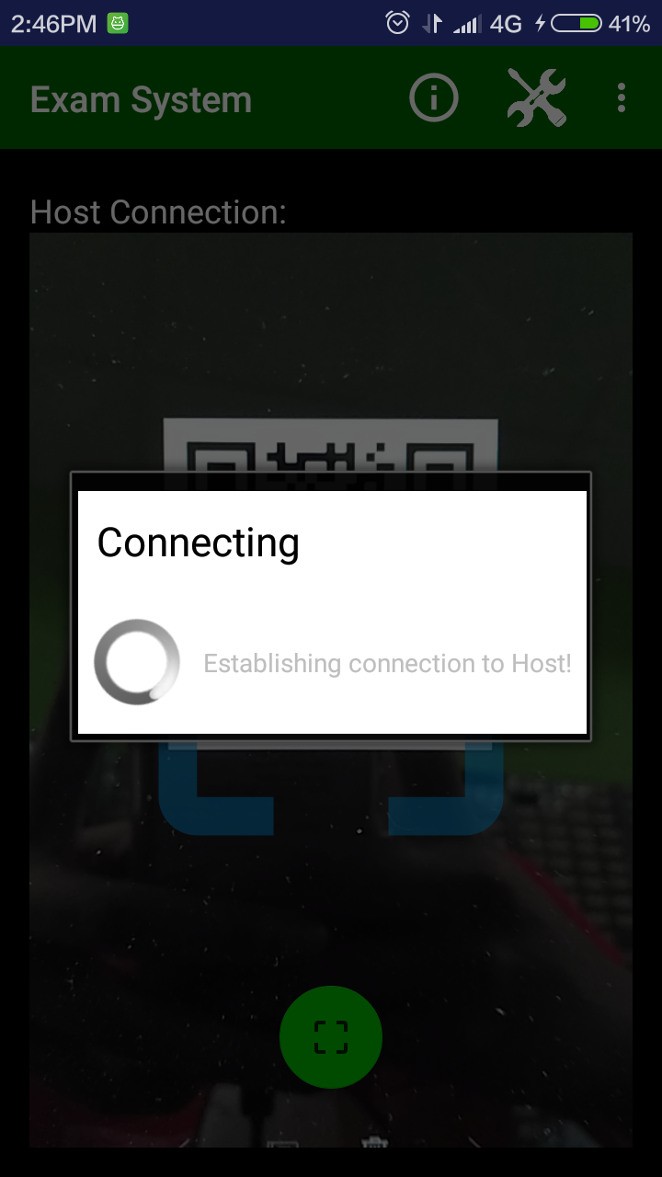
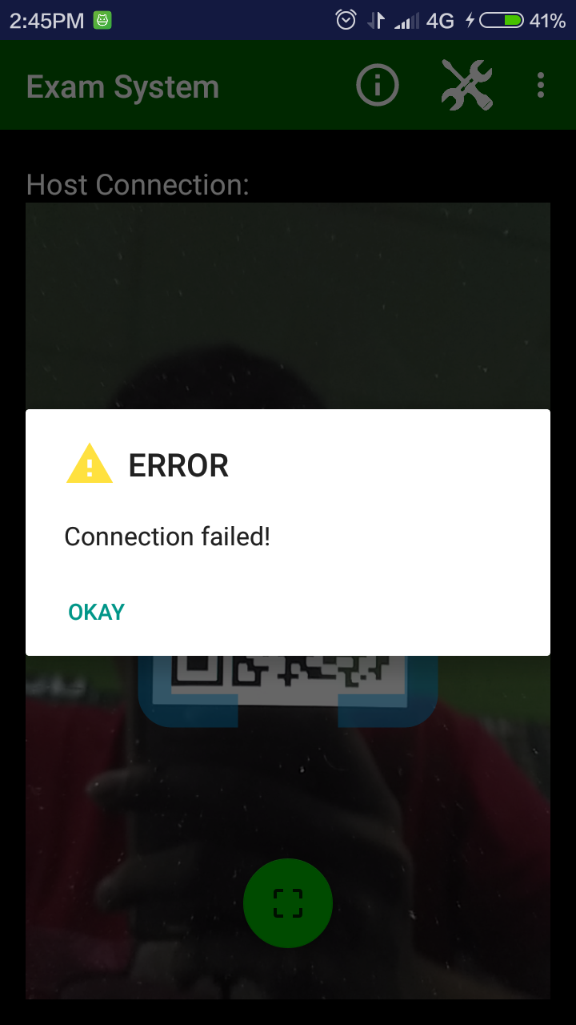

Slide 21
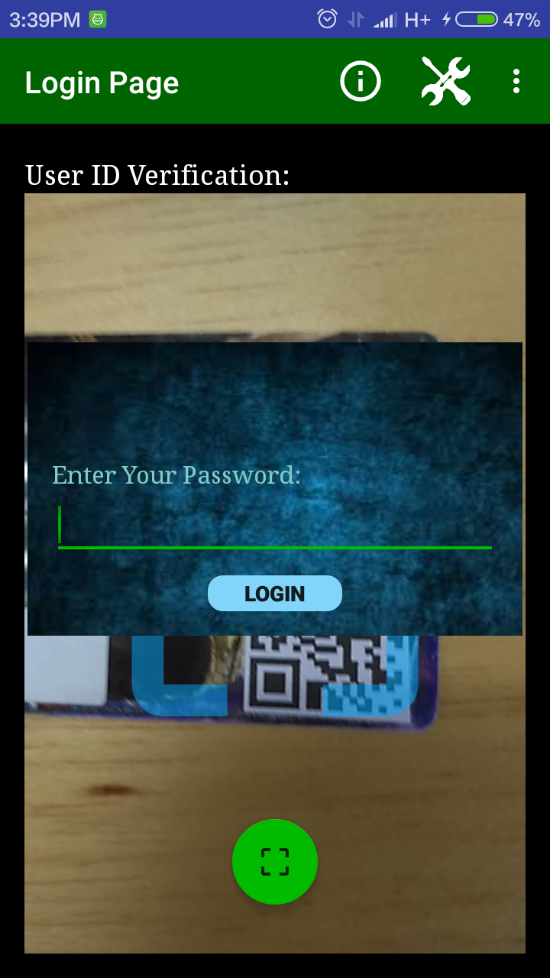
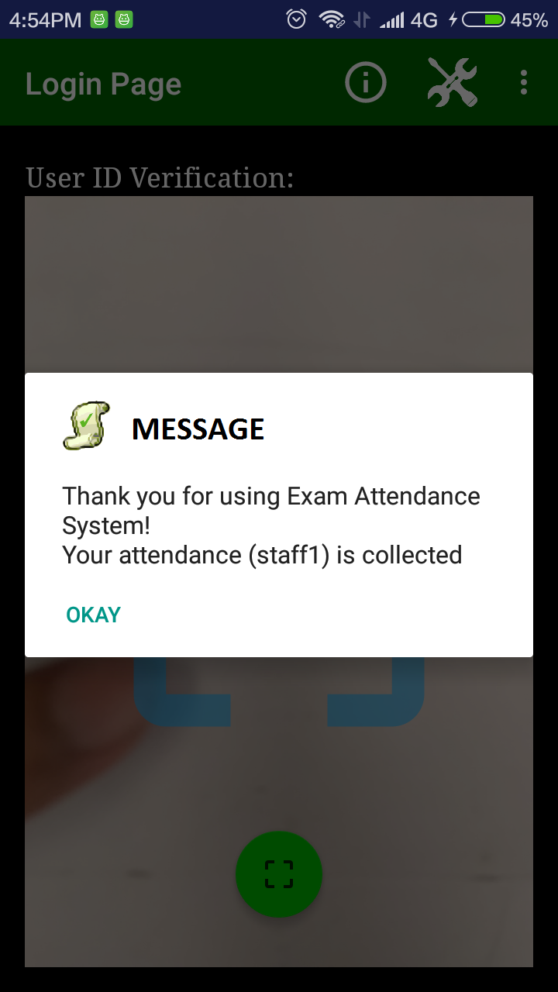
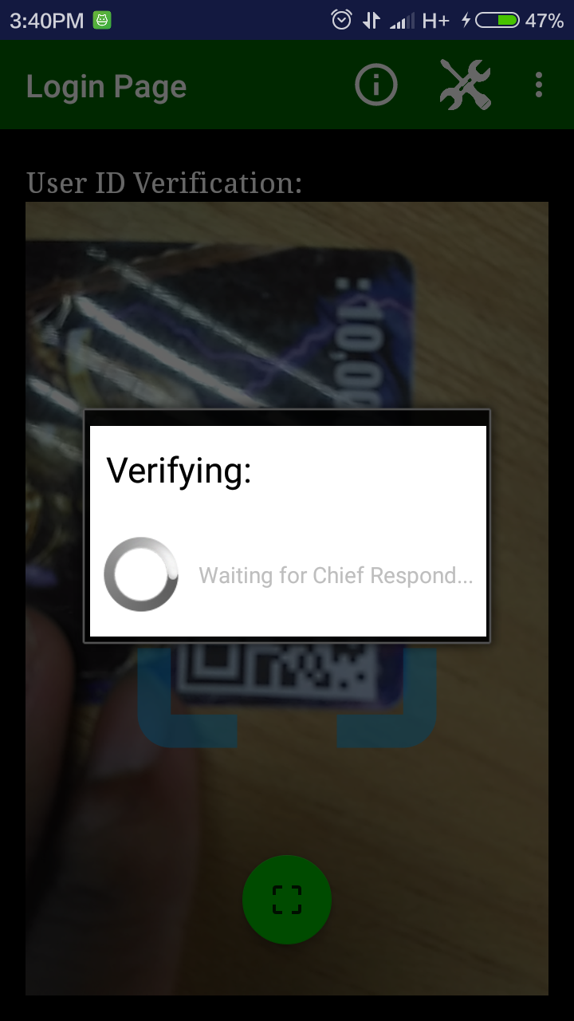
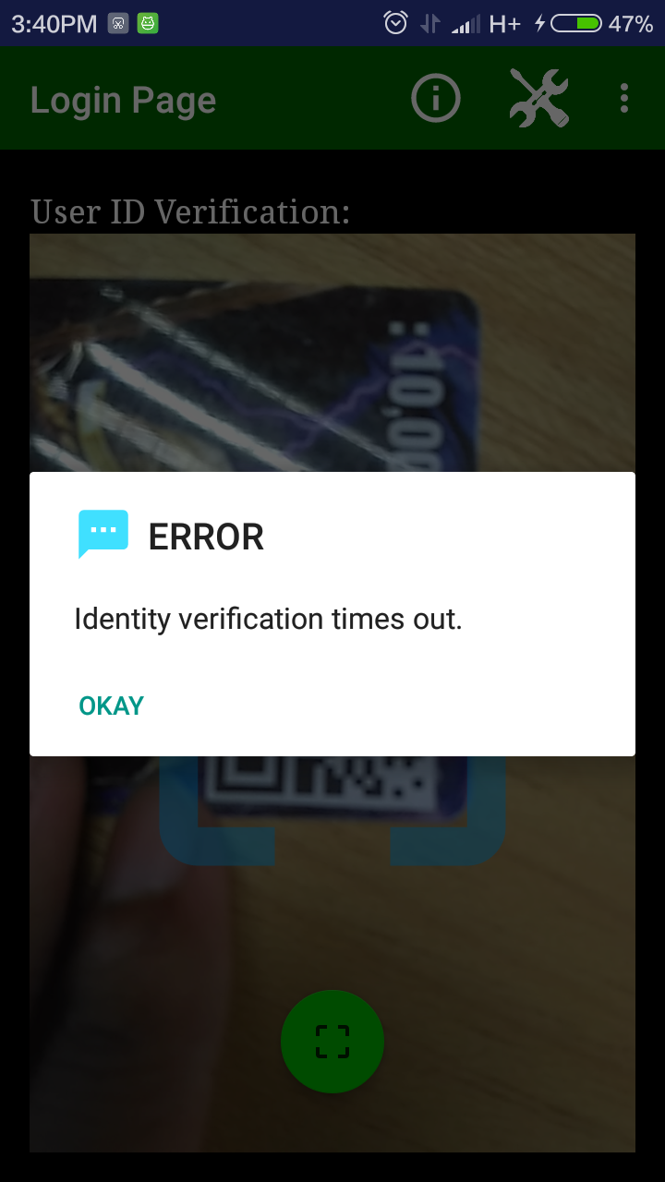
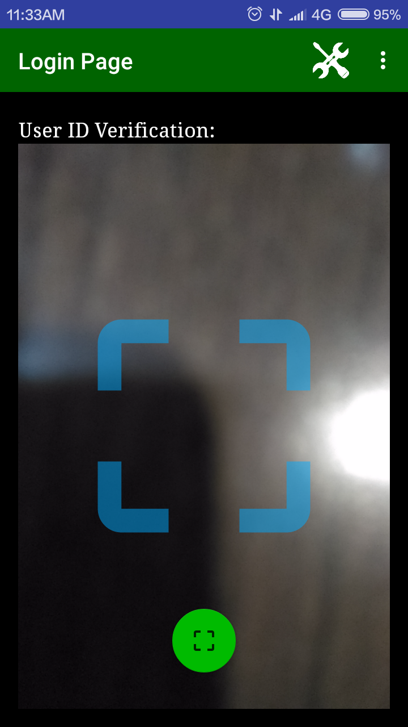

Slide 22
Security

Slide 23

HMAC (keyed-hash message authentication code )
Client
Server
Challenge Message
Password
MAC2
Password
MAC1 = MAC2 ?
MAC1
Challenge Message

Slide 24
Three Way Handshake
Invigilator
Server
Generate random Challenge Message
Crypto Key
Hashing the password
MAC
Match the MACs
Result
Signed in or failed

Slide 25
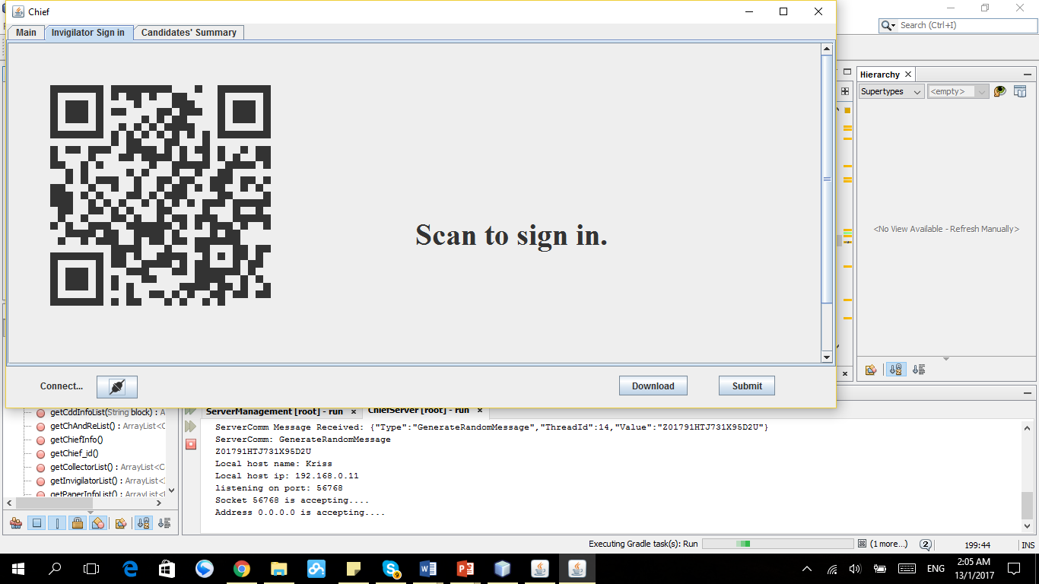
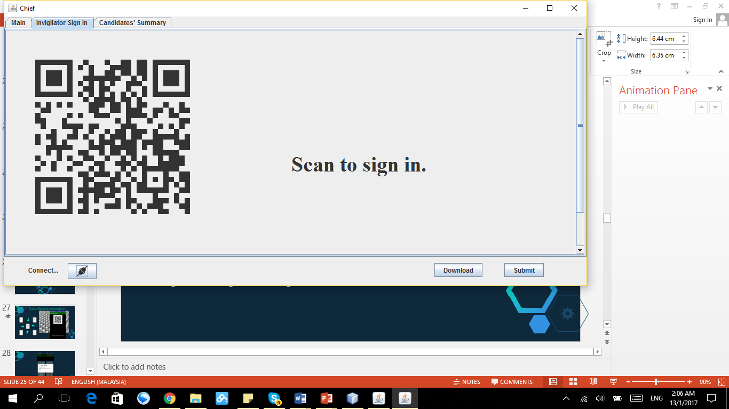
QR regenerate
After get connect
Or
After several seconds

Slide 26
Attendance Collection Revisited:

Slide 27
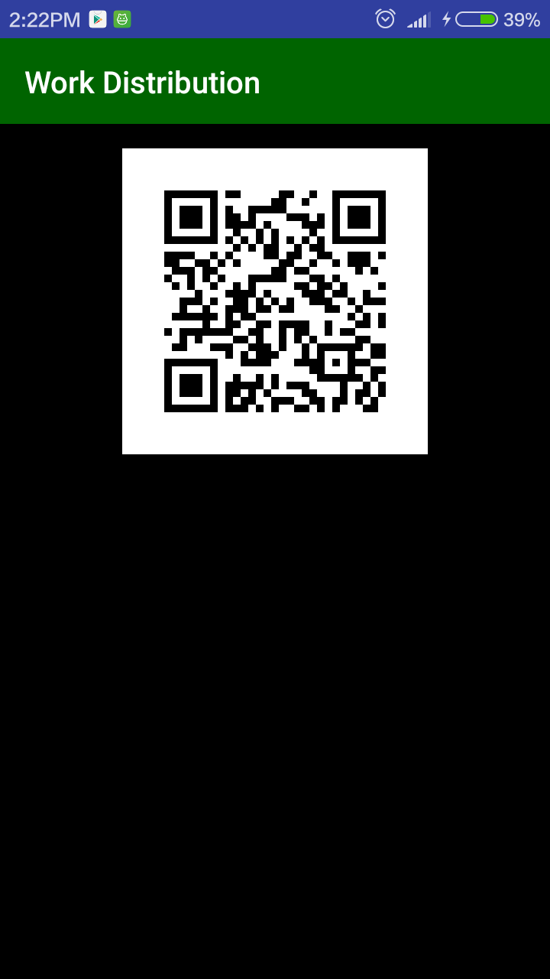
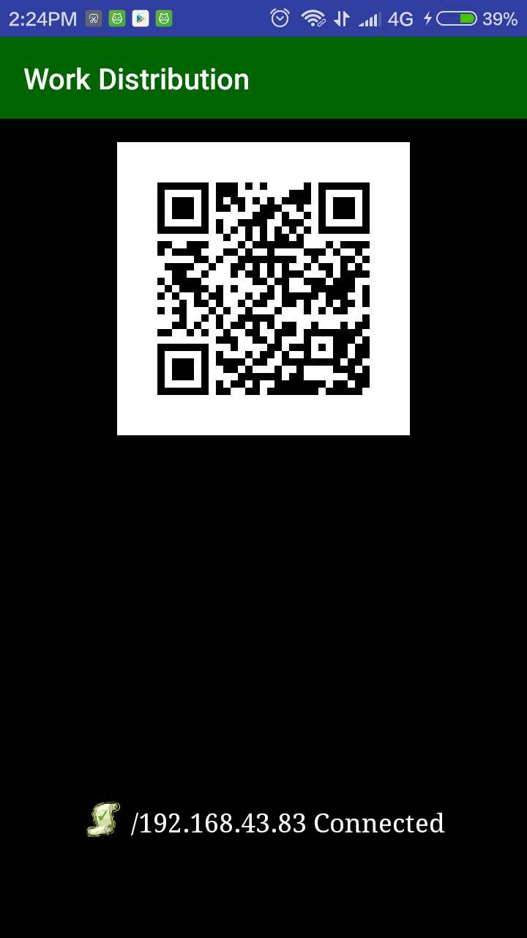

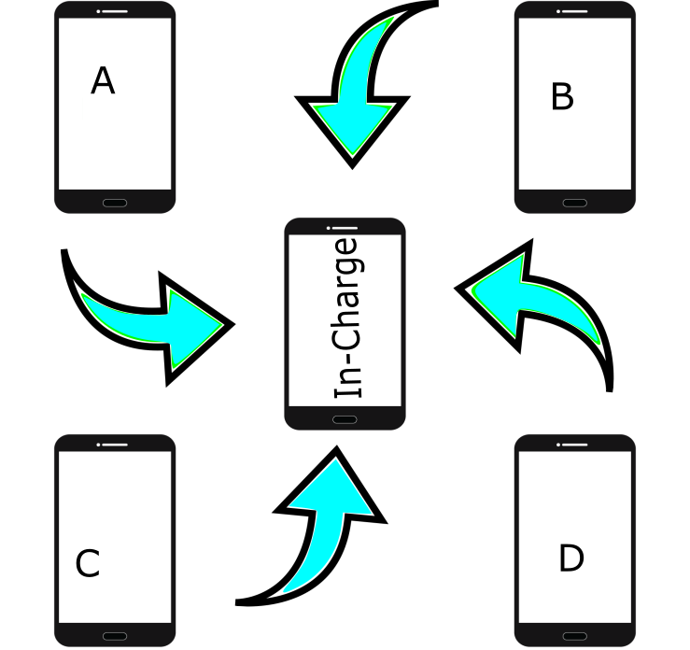
Data Synchronization:

Slide 28
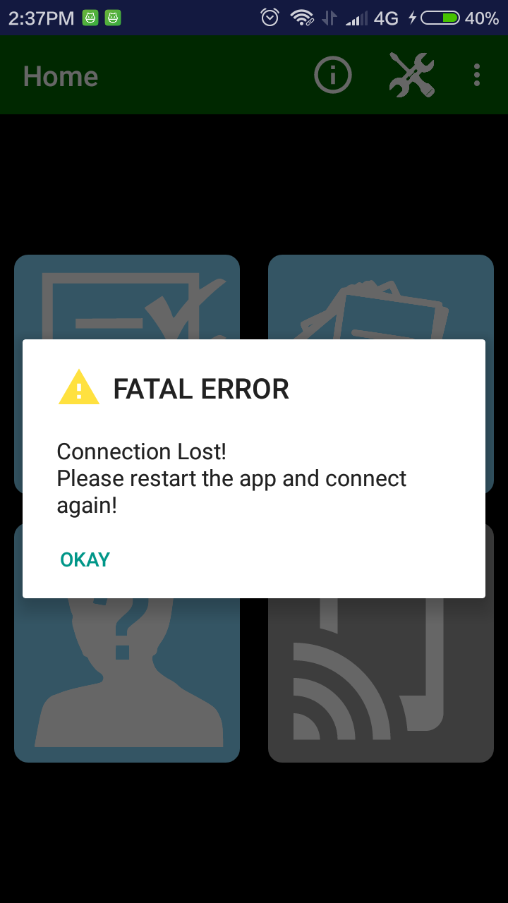

Slide 29
Process of Attendance Report Submission:

Slide 30




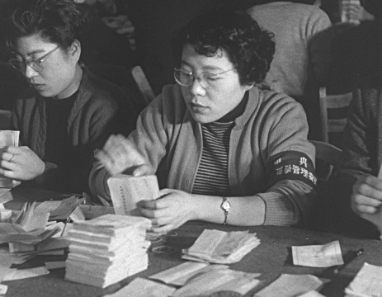

Slide 31
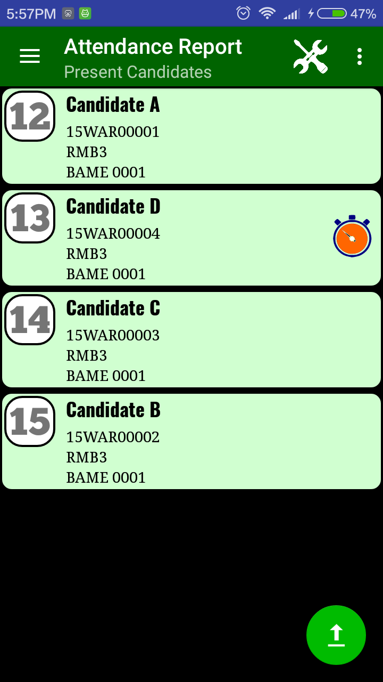
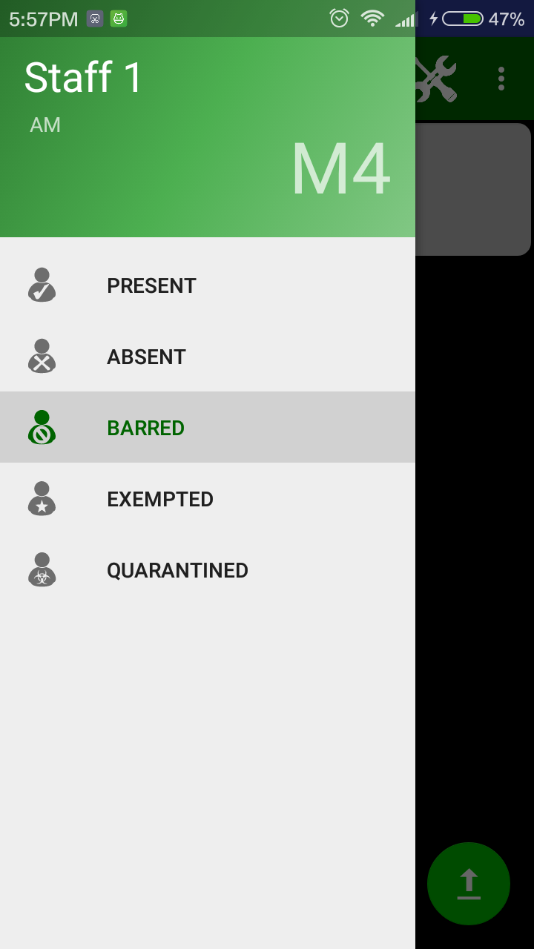
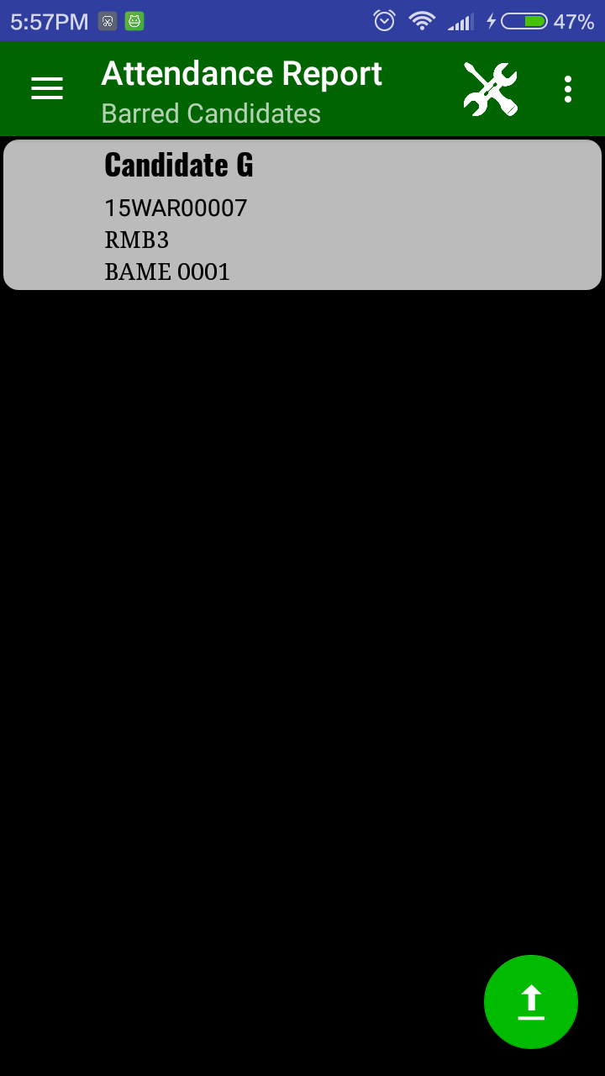
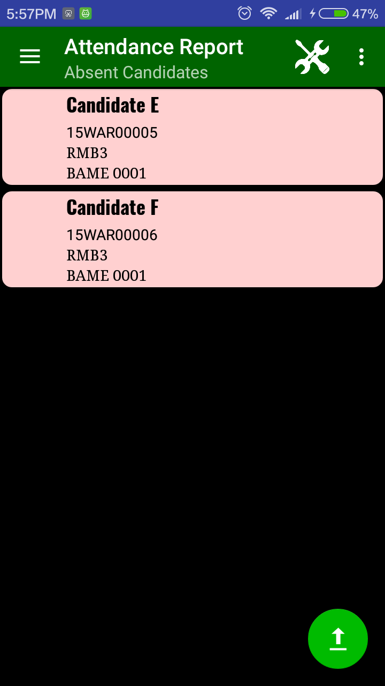
Attendance Report:

Slide 32
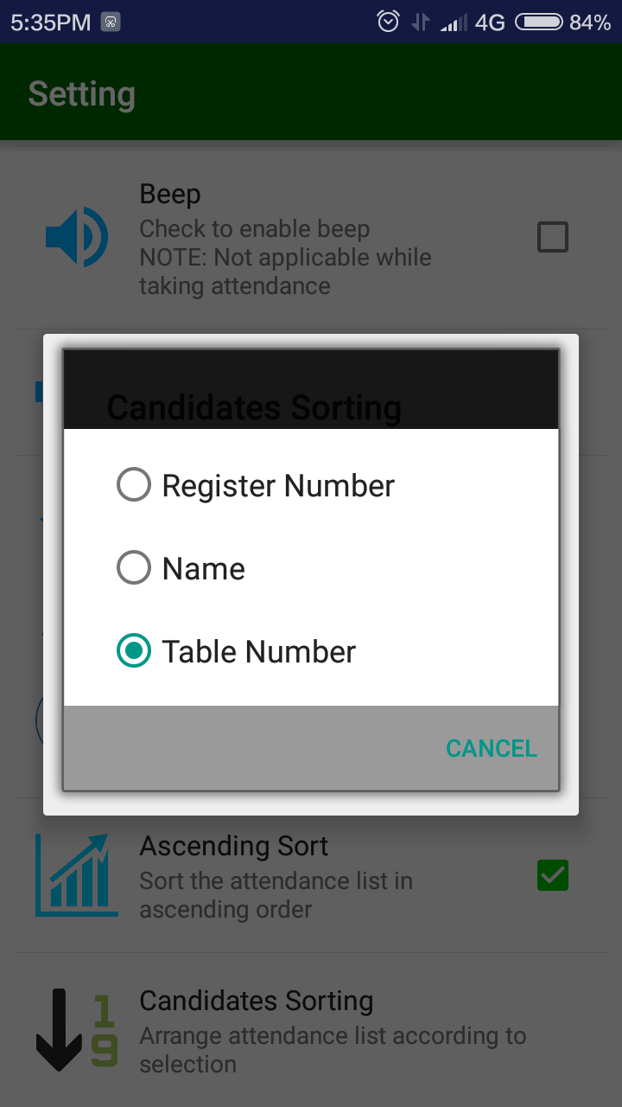
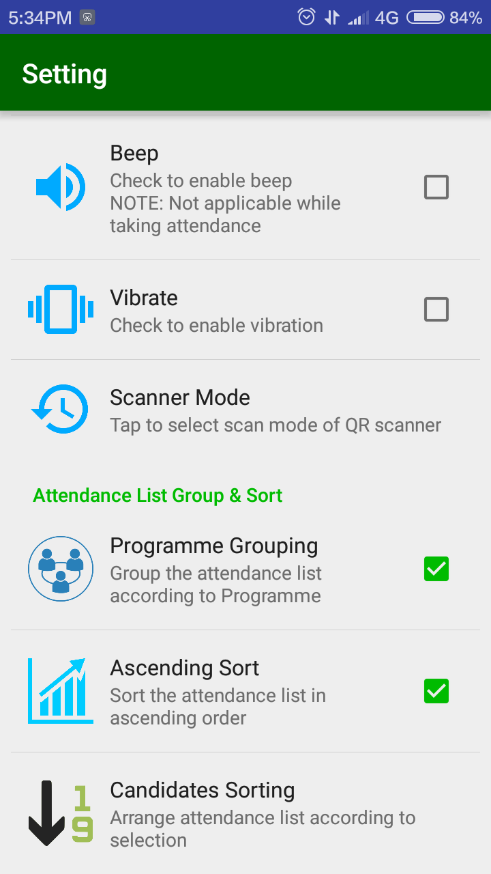

Slide 33
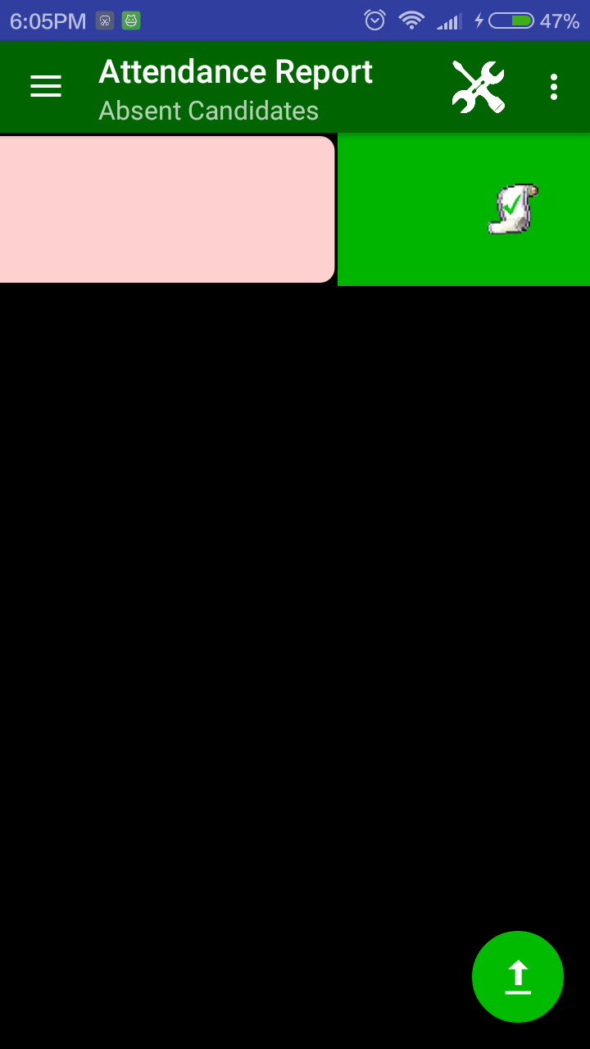
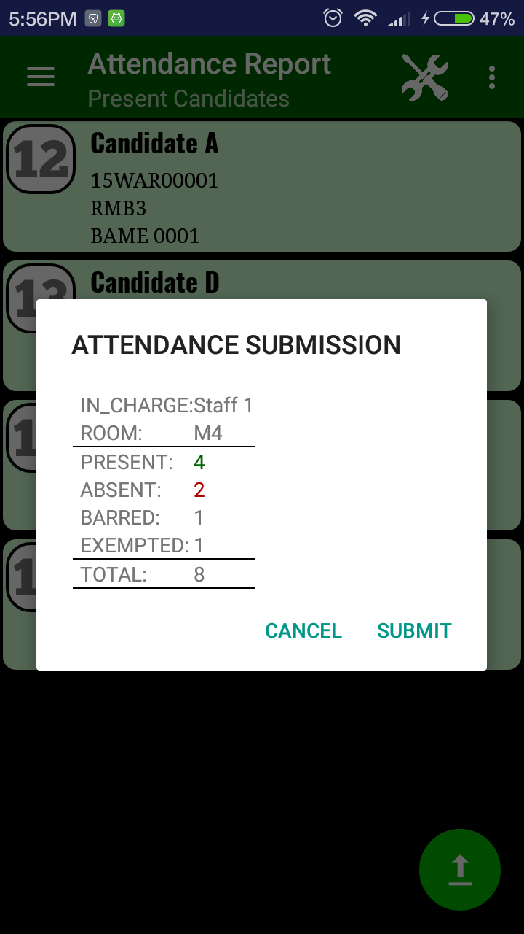
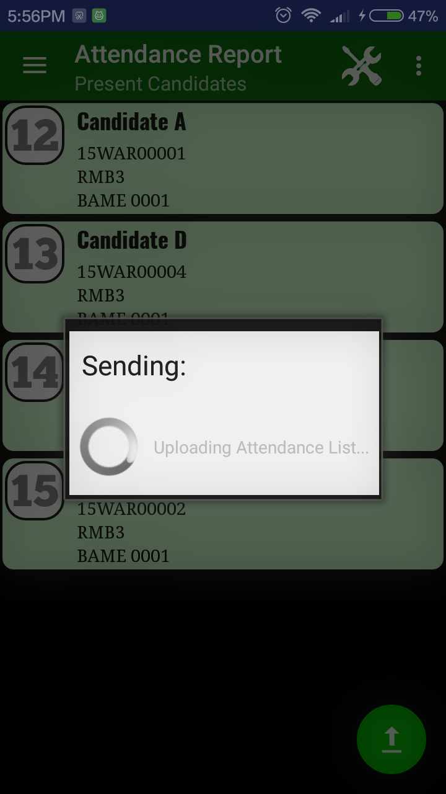
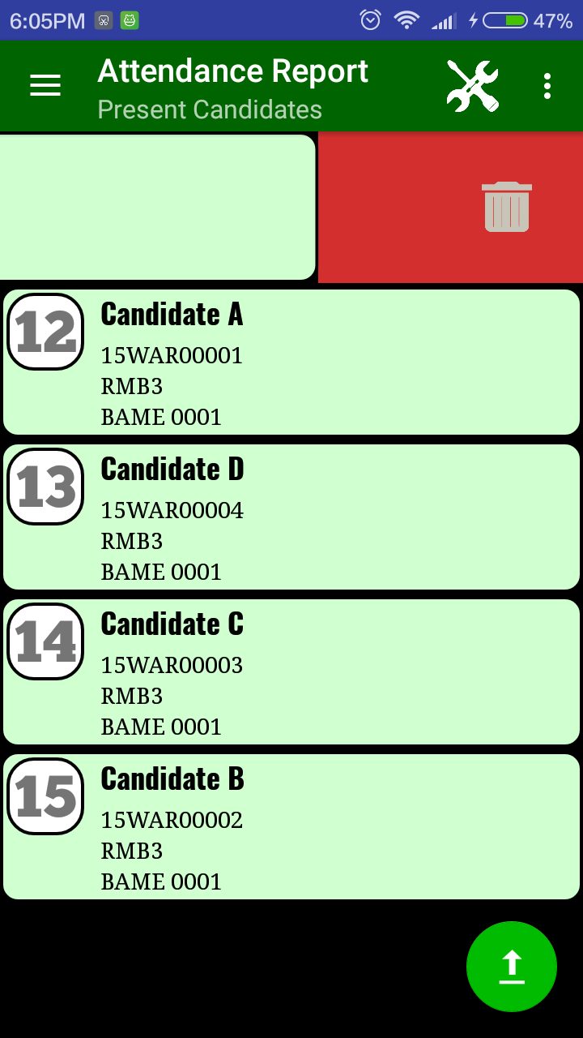

Slide 34
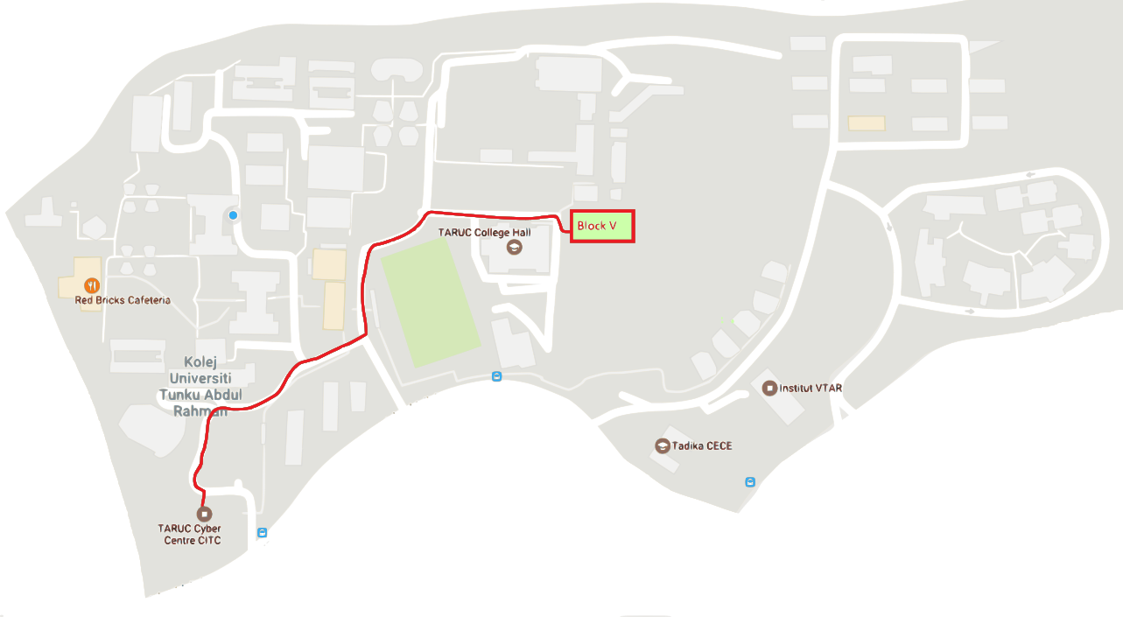




Slide 35
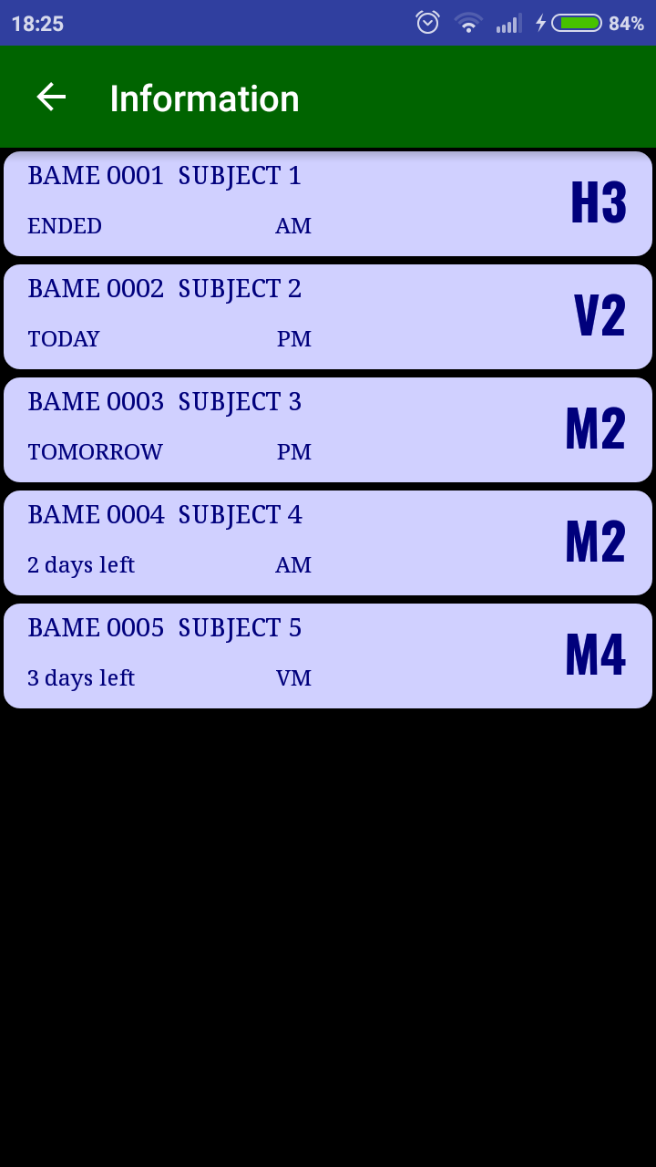
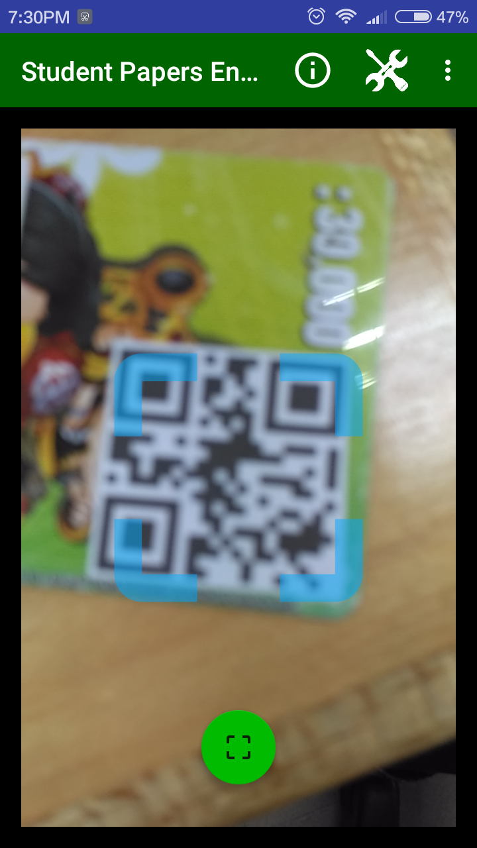
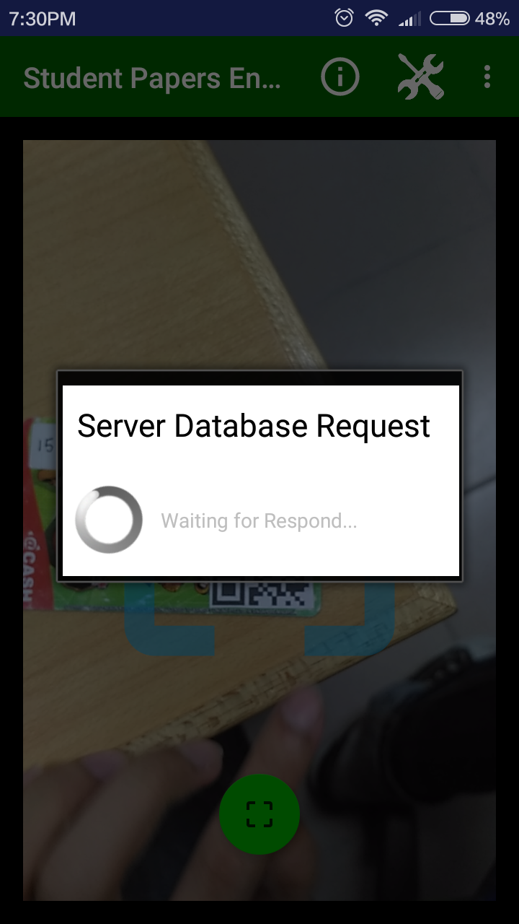
Lost Direction?

Slide 36


Bundle Collection
Bundle ID
Staff ID

Slide 37
Bundle Collection
Staff ID | Bundle ID
Staff1 | Bundle1
Staff1 | Bundle3
Staff2 | Bundle2
Course/Programme/Venue

Slide 38




Slide 39
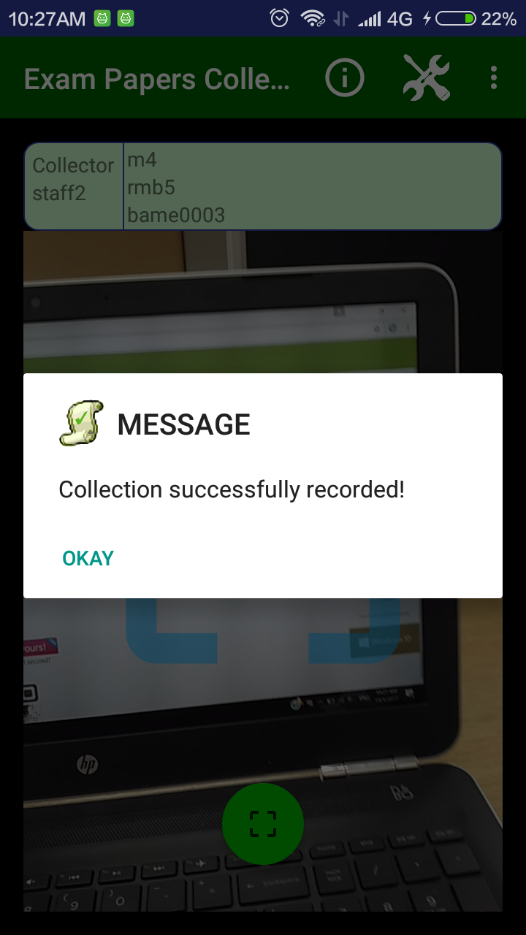
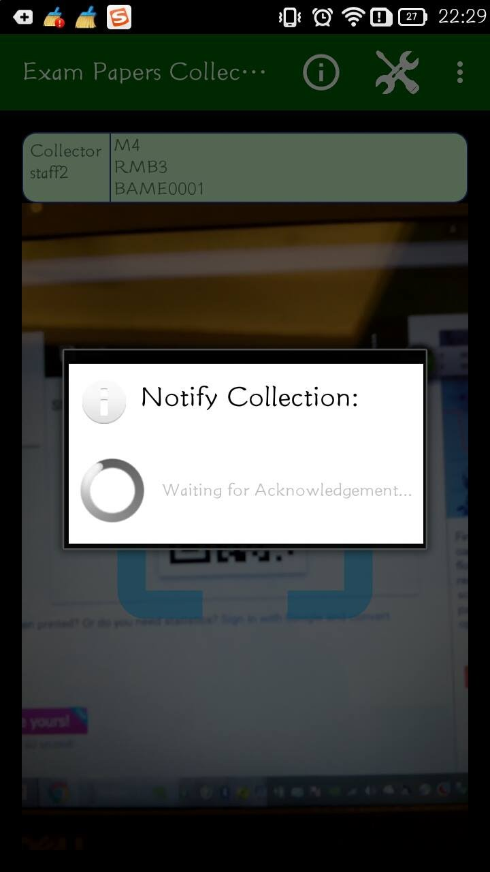
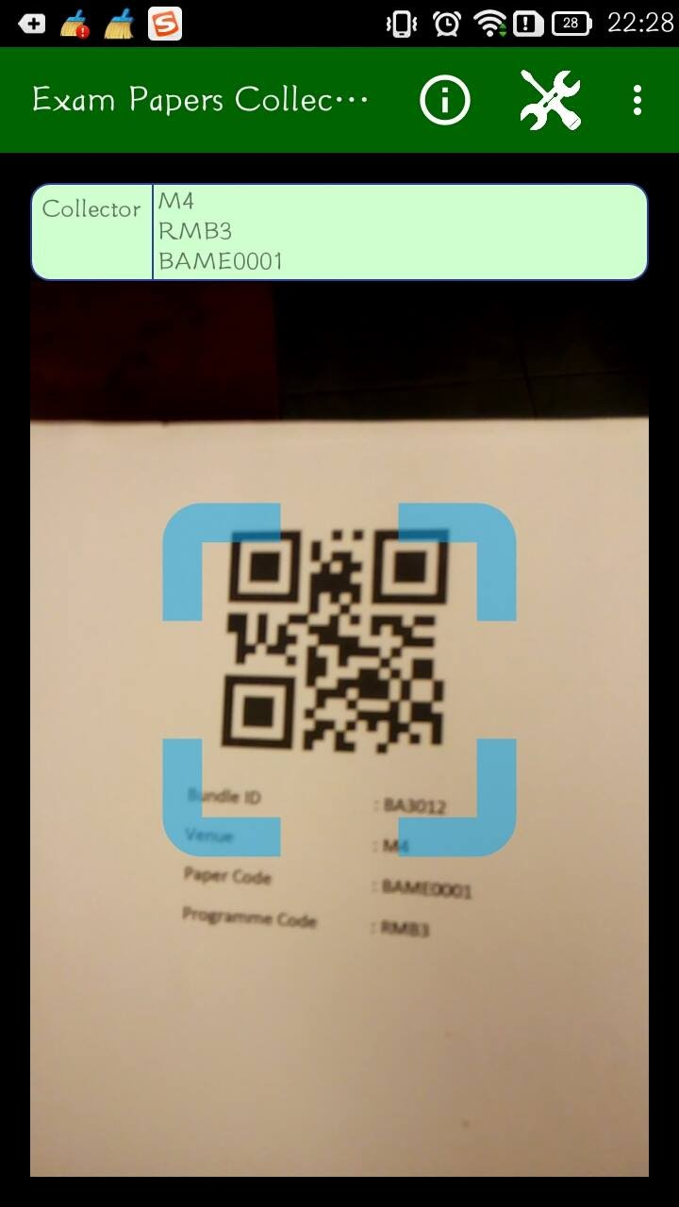

Slide 40
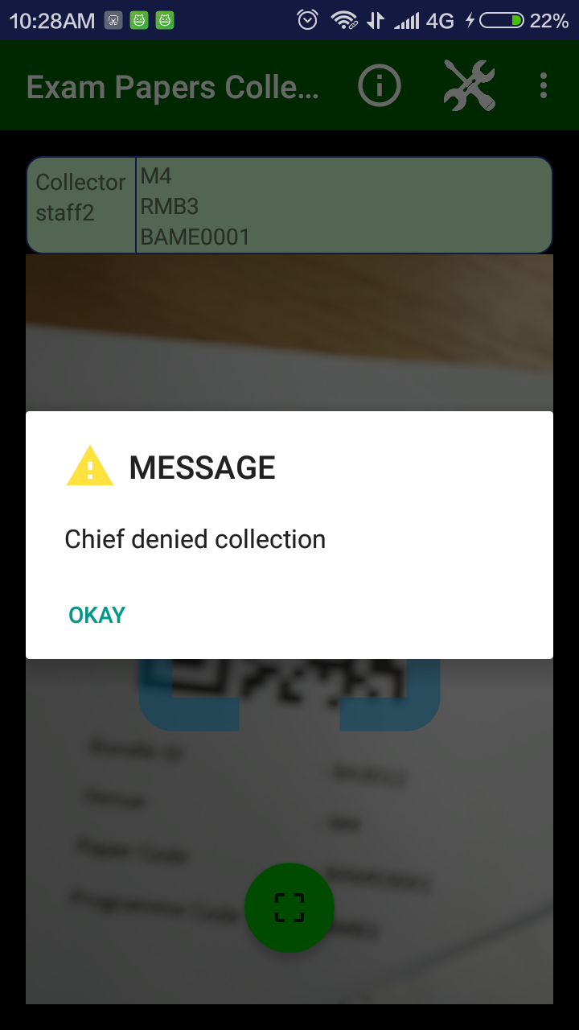
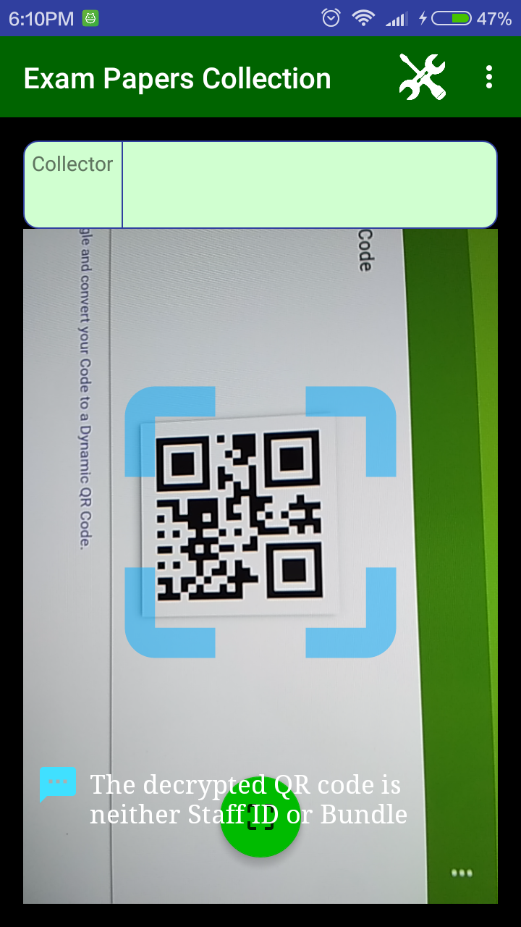

Slide 41
Existing Automated System:
- Fingerprint Attendance System
- RFID Attendance System

Slide 42




Fingerprint based
System:
SecuGen Fingerprint Reader
O. Shoewu, Ph.D. & O.A. Idowu, B.Sc.
May 2012 http://www.akamaiuniversity.us/PJST13_1_300.pdf

Slide 43


RFID based System:
Simon Burkard
2012 http://citeseerx.ist.psu.edu/viewdoc/download?doi=10.1.1.455.3514&rep=rep1&type=pdf

Slide 44




Why QR Code?

Slide 45



Update Update
State View
Update User
Model Events
ZXing (Zebra Crossing)

Slide 46



Custom database

Slide 47
Conclusion:
Improved Efficiency
Minimized Human Error
Reduced usage of Paper
Cost effective and Stable
Minimized Labour Force

Slide 48
THANK YOU!
6-1-2017

